Slide 1

Ramani’s POV QA Script Generation Relational Data Projects Sep 2023
Ramasubramaniam Ramani
https://www.linkedin.com/in/rramani44/

Slide 2
Data Project Observations
Focusing on Data centric projects with relational data stores– data lakes , migration , conversion
50% or more data movements involve no or minimal transformations - identifiers , dates , amounts get moved from layer to layer.
Business can test only a small percentage of the data during functional testing (UI , reports etc)
Technical team must verify the full dataset in the target – conformed (mapped) , complete , controlled (reconciled)
The QA team must certify the full dataset before business testing can begin
Summarizations - Rolled up dimensions

Slide 3
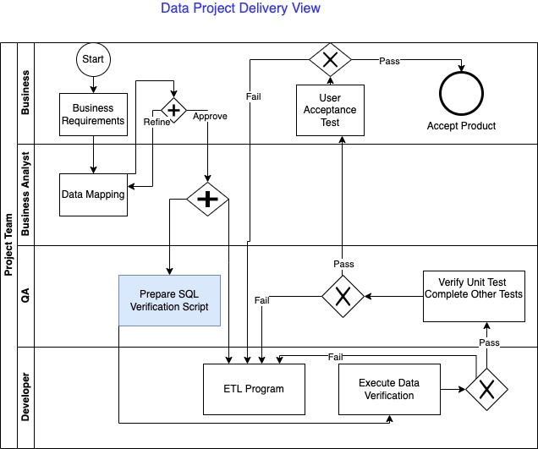
Illustrative Process
The mapping must be approved by business. They might delegate to BA team
BA team works with business and technical teams to complete business and technical maps
Automate the SQL generation as much as possible. Currently this is very manual
Developer will unit test with a few records

Slide 4





Solution Features
Used with a relational database to execute the SQL
Compares all rows and columns and reports differences
Straight Pull
Defaults
Functions
Foundation for Operations dashboard
Could be incorporated into a Devops pipeline
Excel macro generates SQL
Summarizations
Estimated saving between ½ hour to ½ day per ETL pipeline

Slide 5
Sample Output
Discover ! Experiment with the Excel worksheet at https://github.com/ramanirepo/QASqlGen/blob/main/generateCompareSQL_v_1_0.xlsm
Simple pulls and transformations
The difference column indicators are on far right
The columns are listed as pairs – source followed by Target

Slide 6
Sample Output
Discover ! Experiment with the Excel worksheet at https://github.com/ramanirepo/QASqlGen/blob/main/generateCompareSQL_GroupBy_v_1.xlsm
Summarizations
The difference column indicators are on far right
The columns are listed as pairs – source followed by Target

